Slide 1
Quantum Computing
Tech-Arch DAY
2.10.2018
Hassan Naseri, PiNJA Kuosmanen

Slide 2
WELCOME! CONTECTS
Introduction to Quantum Computing
A Peek into Quantum Information Theory
Hello World! and Beyond
QISKIT and OpenQASM
Introduction to Quantum Algorithms
Conclusions

Slide 3
What is QUANTUM Computing?
The information is stored in a quantum system.
The computation/logic is governed by quantum-mechanical phenomena, such as superposition and entanglement.
Quantum information theory provides foundations for quantum computing.
Notes:
The convectional technology of silicon chips is already governed by quantum physics, but the computation is classic.
Quantum information systems (QIS) is different from quantum computing.
Quantum computer does not run classical algorithms on a quantum hardware. The computation method is fundamentally different form classical computing, e.g. your laptop computer is more similar to human brain than to a quantum computer.

Slide 4
TWO MAIN TECHNOLOGIES
Q: Why is it hard to build quantum computers? (https://youtu.be/BDqcJiJbD4Y)
Quantum Annealing Computer
Also known as adiabatic quantum computation
Approximate answers to optimization problems, E.g. DWAVE
Not a universal computer, hence cannot run standard quantum algorithms
no entanglement, no real quantum speedup
Universal Quantum Computer
Quantum Turing machine
Quantum Gate Model / Quantum Circuit
Based on quantum superposition entanglement, and interreference
Can provide quantum speedup on certain algorithms developed for QC.
E.g. IBQ Q, Google, …

Slide 5
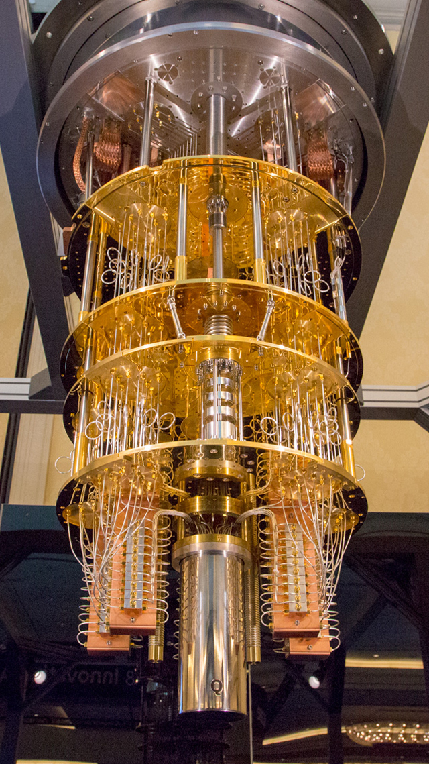
IBM Q System SUPERCONDUCTING CHIPS
IBM Q Experience
A public platform for quantum computing experiments, access to quantum computers, simulators, tools (circuit composer), API, etc.
Public computers: 5 qubit (x2), 16 qubit
Non-public computers: 20 qubit now, 50 qubit soon!
Programming SDK (QISKIT) and open source libraries
Resources are limited.
Technology
Superconducting chips
Dilution refrigerator : starting from liquid helium at 4 Kelvin to 800 milliKelvin, 100 milliKelvin and, finally, 10 milliKelvin.
Noisy Intermediate-Scale Quantum (NISQ) technology
A sophisticated refrigerator

Slide 6
CONTECTS
Introduction to Quantum Computing
A Peek into Quantum Information Theory
Hello World! and Beyond
QISKIT and OpenQASM
Introduction to Quantum Algorithms
Conclusions

Slide 7
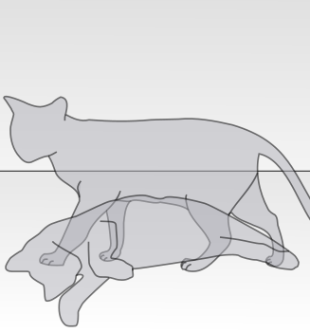
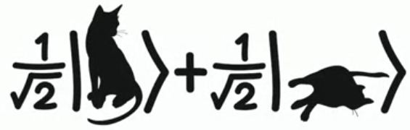
Something about Quantum Physics
Superposition, Collapse, Entanglement, Teleportation
The physics can be difficult and subject to different interpretations.
Mathematics are simple and do not require interpretation.
Two important laws:
Quantum operations are reversible.
Measurement is irreversible
Notes:
Example of linear combination

Slide 8
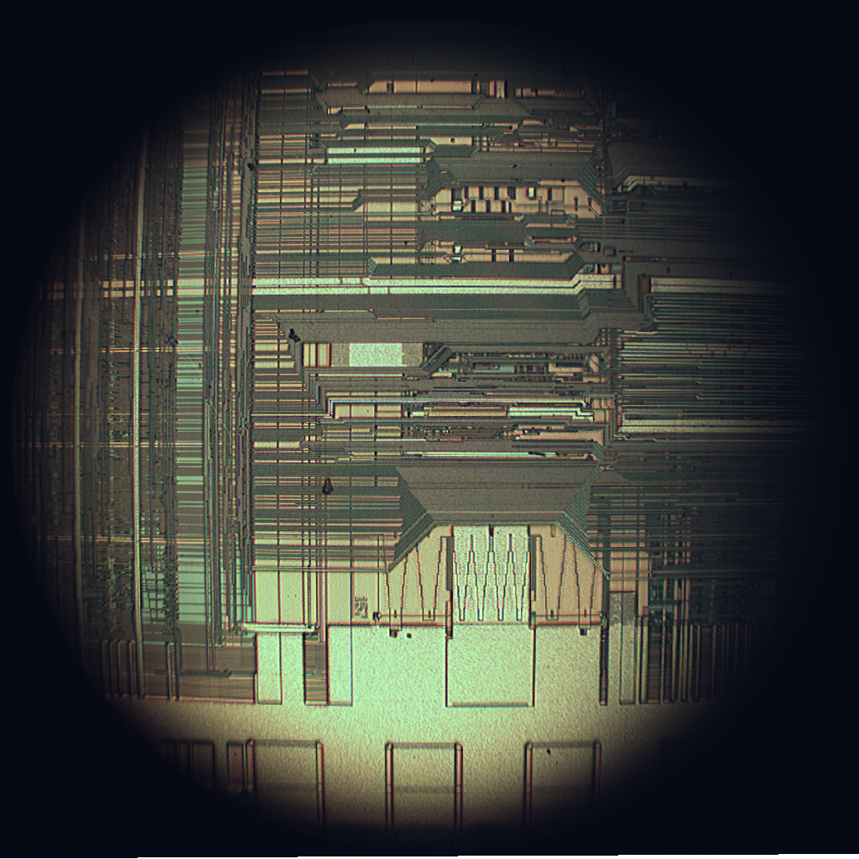
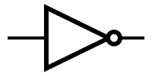
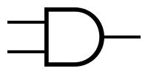
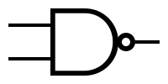

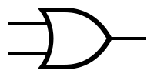


Review of CLASSICAL COMPUTING: MODERN DIGITAL COMPUTERS
Electronic: using electrons to process information
Digital: information units are bits (0/1)
Silicon-based transistor logic (MOSFET)
Basic gates: AND, OR, NAND, …
Universal gates: NAND, NOR
Most system use a single universal gate
Full adder made of NAND gates
Notes:
Finish approximately 12:40

Slide 9
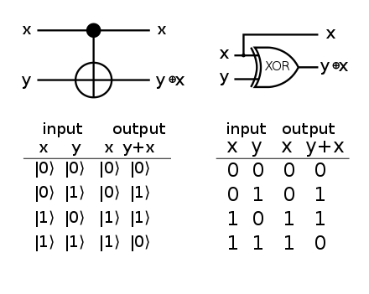
Classical Reversible COMPUTING
An unconventional computing model!
A necessary condition: mapping from states to their successors must be one-to-one.
There has been quite a debate that such a model can perform universal computation.
History:
[1973] Rolf Landauer of IBM: in order for a computational process to be physically reversible, it must also be logically reversible
[Current]
Great body of academic results and proofs of universality.
Reversing cause and effect is no trouble for quantum computers.
There has been no practical reversible logic device technology yet: Quantum computing coming up.
Reversible gates
Example: Controlled NOT (CNOT)
Notes:
Pinja
Classical computing can also be done using reversible logic
Shown 1973
Given the output, it should be possible to produce the input
There should be one to one mapping between input and output
Truth table of the CNOT
Matrix of CNOT

Slide 10


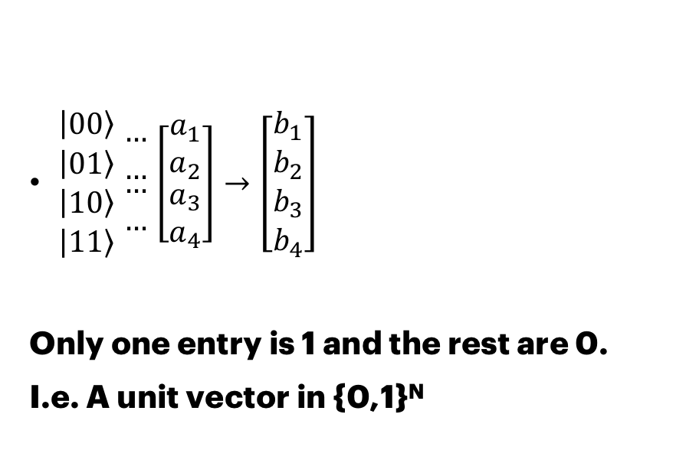
Input/output logic
$\begin{matrix}\left|0\left.0\right\rangle \right. \\ \left|0\left.1\right\rangle \right. \\ \begin{aligned}\left|1\left.0\right\rangle \right. \\ \left|1\left.1\right\rangle \right.\end{aligned}\end{matrix}$ $\begin{matrix}… \\ … \\ \begin{aligned}… \\ …\end{aligned}\end{matrix}$ $\left[\begin{matrix}a_{1} \\ a_{2} \\ \begin{aligned}a_{3} \\ a_{4}\end{aligned}\end{matrix}\right]→\left[\begin{matrix}b_{1} \\ b_{2} \\ \begin{aligned}b_{3} \\ b_{4}\end{aligned}\end{matrix}\right]$
Only one entry is 1 and the rest are 0.
I.e. A unit vector in {0,1}^{N}

Slide 11
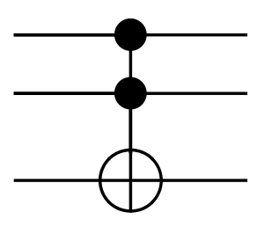
Reversible LOGIC – TOFFOLI GATE
TRUTH TABLE
INPUT |  |  | OUTPUT
0 | 0 | 0 | 0 | 0 | 0
0 | 0 | 1 | 0 | 0 | 1
0 | 1 | 0 | 0 | 1 | 0
0 | 1 | 1 | 0 | 1 | 1
1 | 0 | 0 | 1 | 0 | 0
1 | 0 | 1 | 1 | 0 | 1
1 | 1 | 0 | 1 | 1 | 1
1 | 1 | 1 | 1 | 1 | 0
TOFFOLI gate (CCNOT) is a universal reversible logic gate.
That is, it can implement all Boolean functions
3-bit inputs and 3-bit outputs
If the first two bits are both set to 1, it inverts the third bit, otherwise all bits stay the same.
It can be represented as a permutation matrix for 2³ input/output states.
Input and output can be represented with 8x1 binary vectors.
Notes:
Pinja:
Example of reversible logic: Toffoli (CCNOT)
Universal logic gate → possible to implement all boolean functions
3-bit inputs and outputs → 8 (2^3) rows and columns in the matrix
Works in similar fashion than cnot, if first two bits are 1 then inverts the third one. Otherwise all stay the same
CNOT matrix multiplication example
Finish approximately 13:00

Slide 12
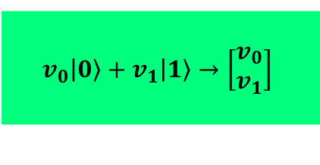
What is a QUBIT?
Left
The fundamental unit of quantum information.
Linear combination of two or more states.
Physical implementation can very, and there are different technologies.
Measurement: induces “collapse” in quantum state (to eigenvectors)
The vector representation of a single qubit:
Right
$$v_{0}\left|\left.0\right\rangle +v_{1}\right|\left.1\right\rangle →\left[\begin{matrix}v_{0} \\ v_{1}\end{matrix}\right]$$

Slide 13
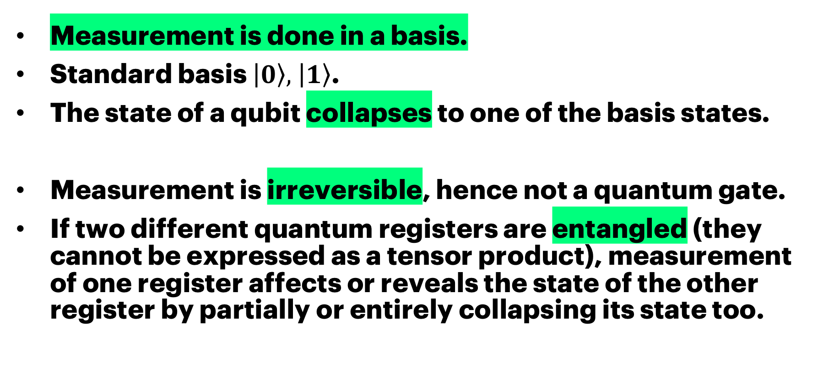
Measurement
Measurement is done in a basis.
Standard basis $\left|\left.0\right\rangle , \right|\left.1\right\rangle$.
The state of a qubit collapses to one of the basis states.
Measurement is irreversible, hence not a quantum gate.
If two different quantum registers are entangled (they cannot be expressed as a tensor product), measurement of one register affects or reveals the state of the other register by partially or entirely collapsing its state too.

Slide 14
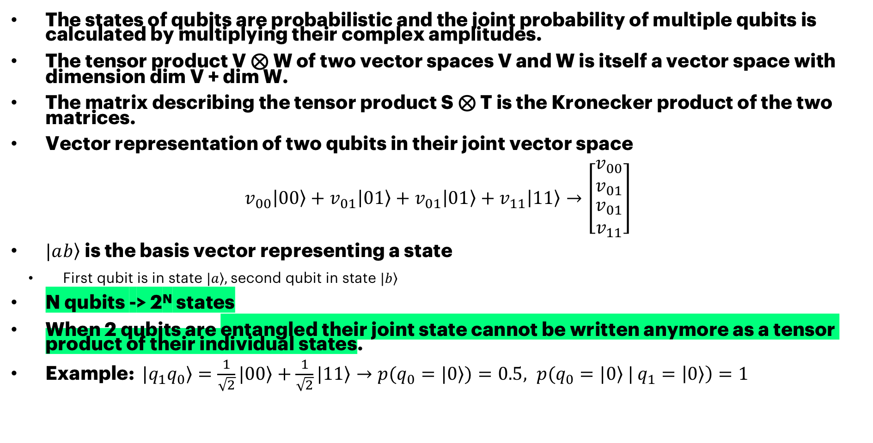
VECTOR SPACE AND ENTAGLEMENT
The states of qubits are probabilistic and the joint probability of multiple qubits is calculated by multiplying their complex amplitudes.
The tensor product V ⊗ W of two vector spaces V and W is itself a vector space with dimension dim V + dim W.
The matrix describing the tensor product S ⊗ T is the Kronecker product of the two matrices.
Vector representation of two qubits in their joint vector space
$$v_{00}\left|\left.00\right\rangle +v_{01}\right|0\left.1\right\rangle +v_{01}\left|\left.01\right\rangle +v_{11}\right|1\left.1\right\rangle →\left[\begin{matrix}v_{00} \\ v_{01} \\ \begin{aligned}v_{01} \\ v_{11}\end{aligned}\end{matrix}\right]$$
$|a\left.b\right\rangle$is the basis vector representing a state
First qubit is in state $\left.|a\right\rangle ,$second qubit in state $\left.|b\right\rangle$
N qubits -> 2^{N} states
When 2 qubits are entangled their joint state cannot be written anymore as a tensor product of their individual states.
Example: $|\left.q_{1}q_{0}\right\rangle =\frac{1}{\sqrt{2}}|\left.00\right\rangle +\frac{1}{\sqrt{2}}|1\left.1\right\rangle →p(q_{0}=|\left.0\right\rangle )=0.5, p(q_{0}=|\left.0\right\rangle |$ $q_{1}=\left|\left.0\right\rangle \right)=1$

Slide 15
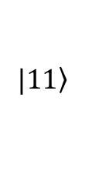
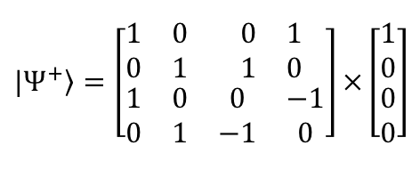
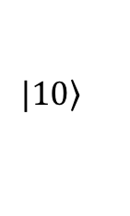
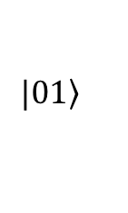
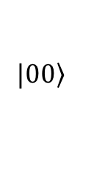
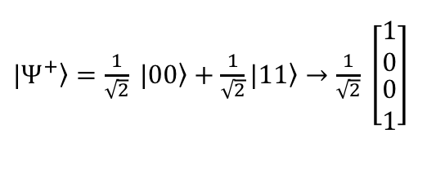
Quantum Information THEORY
Bell states:
Quantum states of two qubits that represent the simplest examples of quantum entanglement (known as an EPR pair).
Algebraic representation:
Quantum computation is done using quantum mechanics operation.
Operations are unitary transformations (preserves the inner product).
Operations can be performed/represented using linear algebra.
Each operation (or the whole process) has unitary matrix.
The vectors/matrices are complex-valued.
$$\left.|00\right\rangle$$
$\left.{|Ψ}^{+}\right\rangle =\frac{1}{\sqrt{2}} \left.|00\right\rangle +\frac{1}{\sqrt{2}}|\left.11\right\rangle →$ $\frac{1}{\sqrt{2}} \left[\begin{matrix}\begin{matrix}1 \\ 0\end{matrix} \\ \begin{matrix}0 \\ 1\end{matrix}\end{matrix}\right]$
$$\left.|01\right\rangle$$
$$\left.|10\right\rangle$$
$$\left.|11\right\rangle$$
$$|\left.Ψ^{+}\right\rangle =\left[\begin{matrix}\begin{matrix}1 & 0 \\ 0 & 1\end{matrix} & \begin{matrix}0 & 1 \\ 1 & 0\end{matrix} \\ \begin{matrix}1 & 0 \\ 0 & 1\end{matrix} & \begin{matrix}0 & −1 \\ −1 & 0\end{matrix}\end{matrix}\right]×\left[\begin{matrix}\begin{matrix}1 \\ 0\end{matrix} \\ \begin{matrix}0 \\ 0\end{matrix}\end{matrix}\right]$$

Slide 16
Quantum Gate Model HOW DOES A UNIVERSAL QUANTUM COMPUTER WORK?
A universal quantum computer made form simple gates.
Most common gates: 1-qubit and 2-qubit gates
Quantum logic gates are reversible.
Quantum logic gates are represented by unitary matrices.
The state of a qubit is not known before measurement.
The base vectors are the only possible outcomes if measured, not the actual amplitudes.
Due to this inherent randomness (and also noise), the process is repeated and measured many times to find the probabilities of each state.

Slide 17
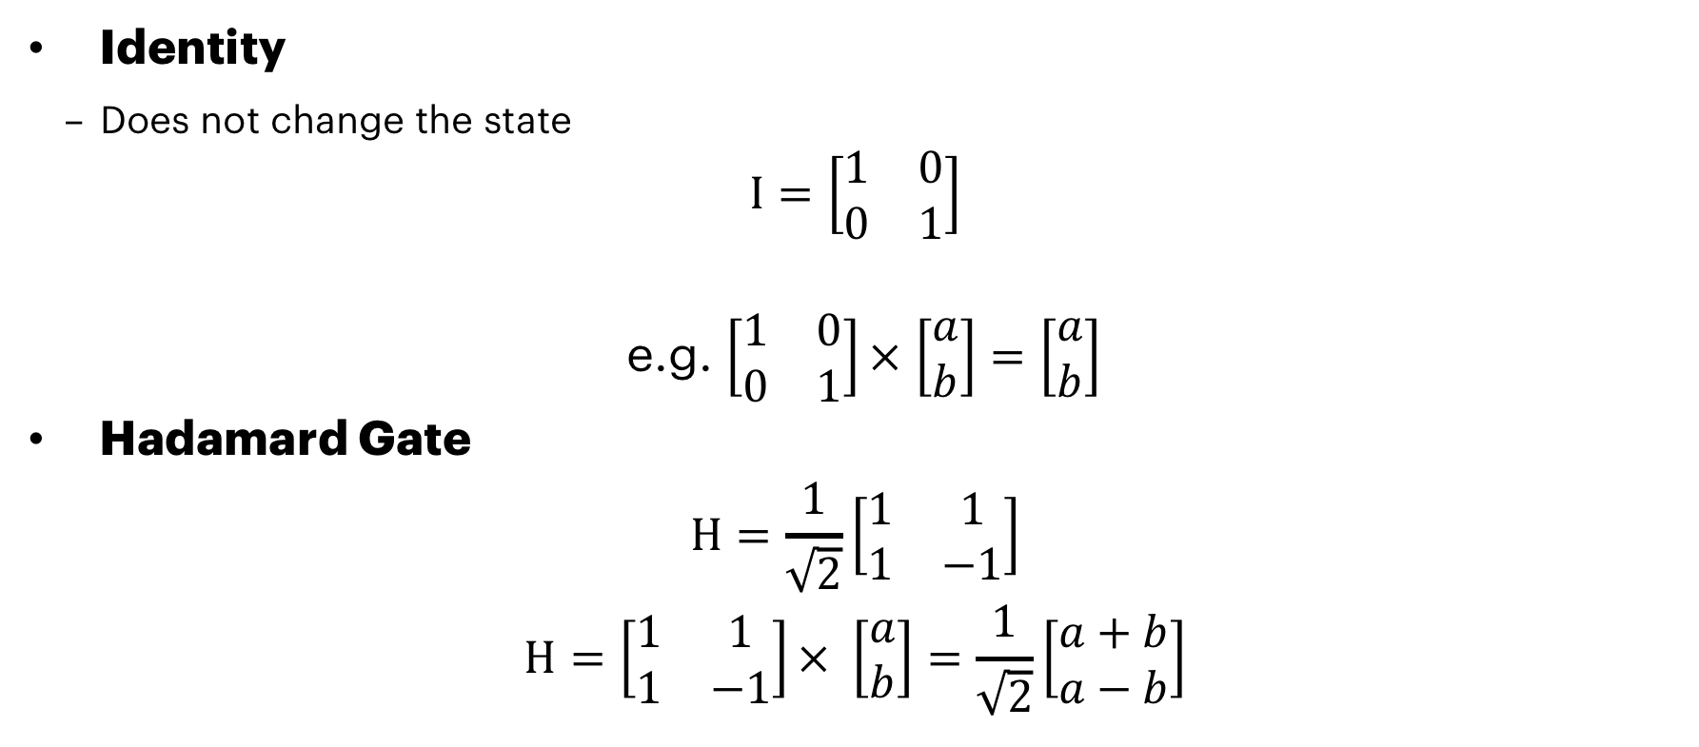
IDENTITY Hadamard GAteS
Identity
Does not change the state
$$I=\left[\begin{matrix}1 & 0 \\ 0 & 1\end{matrix}\right]$$
e.g. $\left[\begin{matrix}1 & 0 \\ 0 & 1\end{matrix}\right]×$ $\left[\begin{matrix}a \\ b\end{matrix}\right]=\left[\begin{matrix}a \\ b\end{matrix}\right]$
Hadamard Gate
$$H=\frac{1}{\sqrt{2}}\left[\begin{matrix}1 & 1 \\ 1 & −1\end{matrix}\right]$$
$$H=\left[\begin{matrix}1 & 1 \\ 1 & −1\end{matrix}\right]× \left[\begin{matrix}a \\ b\end{matrix}\right]=\frac{1}{\sqrt{2}}\left[\begin{matrix}a+b \\ a−b\end{matrix}\right]$$
I
H

Slide 18
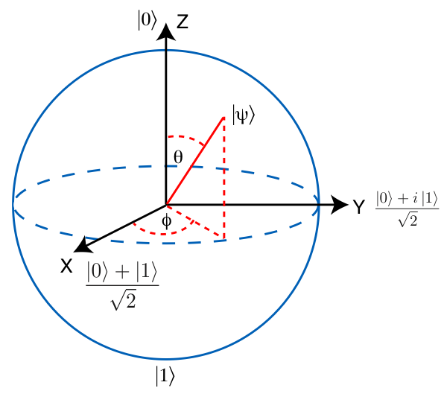
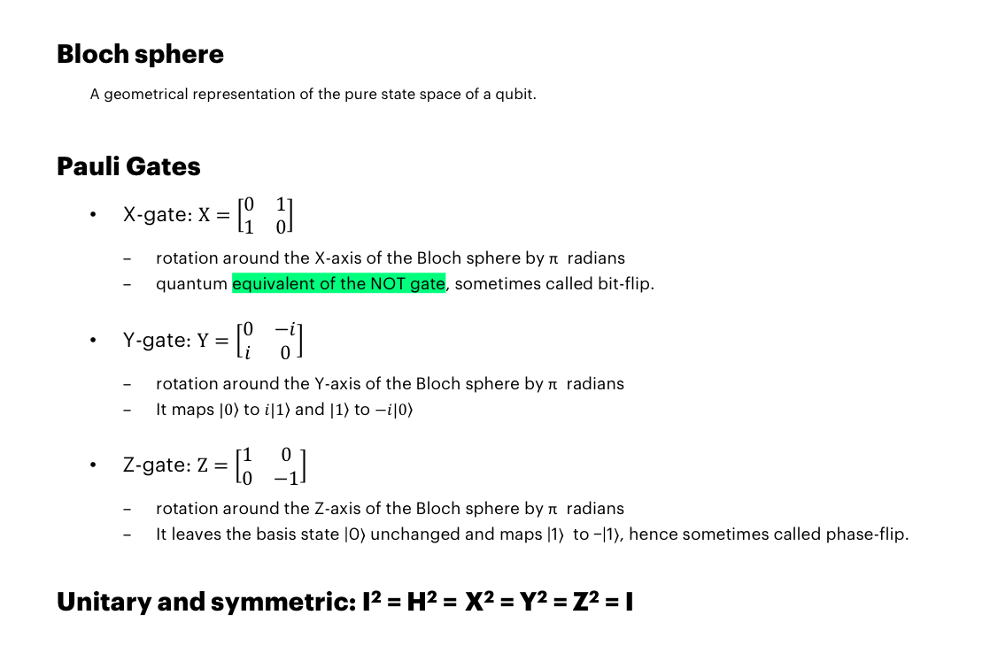
Bloch Sphere and Pauli gates
Bloch sphere
A geometrical representation of the pure state space of a qubit.
Pauli Gates
X-gate: $X=\left[\begin{matrix}0 & 1 \\ 1 & 0\end{matrix}\right]$
rotation around the X-axis of the Bloch sphere by π radians
quantum equivalent of the NOT gate, sometimes called bit-flip.
Y-gate: $Y=\left[\begin{matrix}0 & −i \\ i & 0\end{matrix}\right]$
rotation around the Y-axis of the Bloch sphere by π radians
It maps $\left.|0\right\rangle$ to $\left.i|1\right\rangle$ and $\left.|1\right\rangle$ to $\left.−i|0\right\rangle$
Z-gate: $Z=\left[\begin{matrix}1 & 0 \\ 0 & −1\end{matrix}\right]$
rotation around the Z-axis of the Bloch sphere by π radians
It leaves the basis state |0⟩ unchanged and maps |1⟩ to −|1⟩, hence sometimes called phase-flip.
Unitary and symmetric: I² = H² = X² = Y² = Z² = I
X
Y
Z

Slide 19
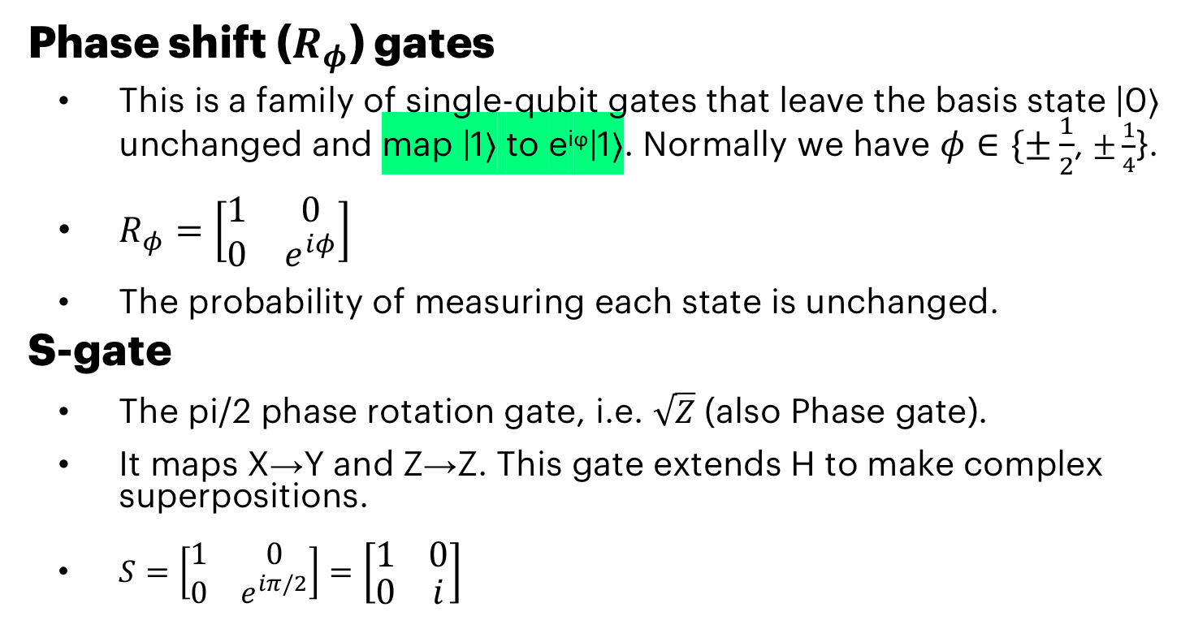
Phase SHIFT GATES
Phase shift ($R_{φ}$) gates
This is a family of single-qubit gates that leave the basis state |0⟩ unchanged and map |1⟩ to e^{iϕ}|1⟩. Normally we have $φ∈\{±\frac{1}{2}$, $±\frac{1}{4}$}.
$R_{φ}=\left[\begin{matrix}1 & 0 \\ 0 & e^{iφ}\end{matrix}\right]$
The probability of measuring each state is unchanged.
S-gate
The pi/2 phase rotation gate, i.e. $\sqrt{Z}$ (also Phase gate).
It maps X→Y and Z→Z. This gate extends H to make complex superpositions.
$S=\left[\begin{matrix}1 & 0 \\ 0 & e^{iπ/2}\end{matrix}\right]=\left[\begin{matrix}1 & 0 \\ 0 & i\end{matrix}\right]$
S
Z^{1/2}

Slide 20
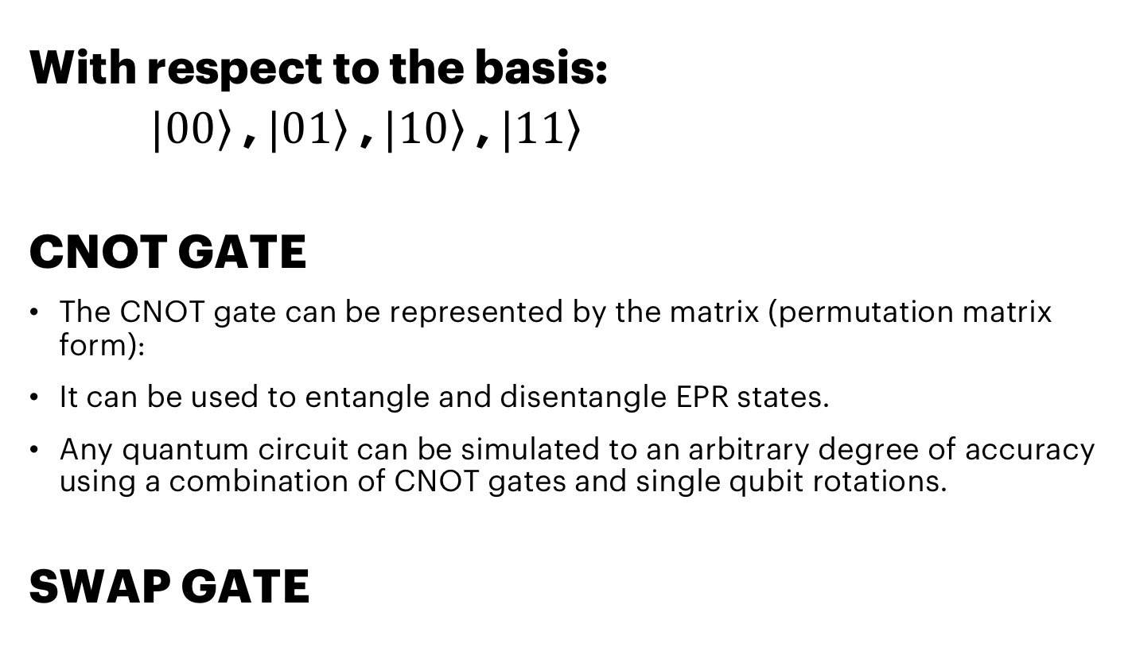
TWO-Qubit gates
With respect to the basis:
$|0\left.0\right\rangle$, $|0\left.1\right\rangle$, $|1\left.0\right\rangle$, $|1\left.1\right\rangle$
CNOT GATE
The CNOT gate can be represented by the matrix (permutation matrix form):
It can be used to entangle and disentangle EPR states.
Any quantum circuit can be simulated to an arbitrary degree of accuracy using a combination of CNOT gates and single qubit rotations.
SWAP GATE

Slide 21
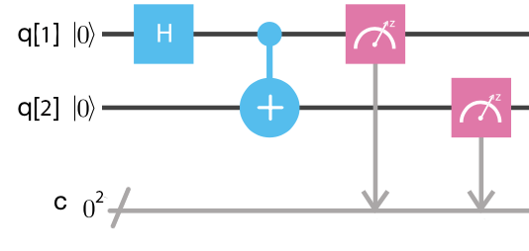
QUANTUM CIRCUITS SUPERPOSITION, ENTAGLEMENT, INTERFERENCE, COLLAPSE
Bell states
The first Bell state can be created using a Hadamard gate and a CNOT gate.
Measurement of one qubit will assign one of two possible values to the other qubit instantly.
Notes:
Finish approximately 13:50

Slide 22
CONTECTS
Introduction to Quantum Computing
A Peek into Quantum Information Theory
Hello World! and Beyond
QISKIT and OpenQASM
An Example of a Quantum Algorithm

Slide 23
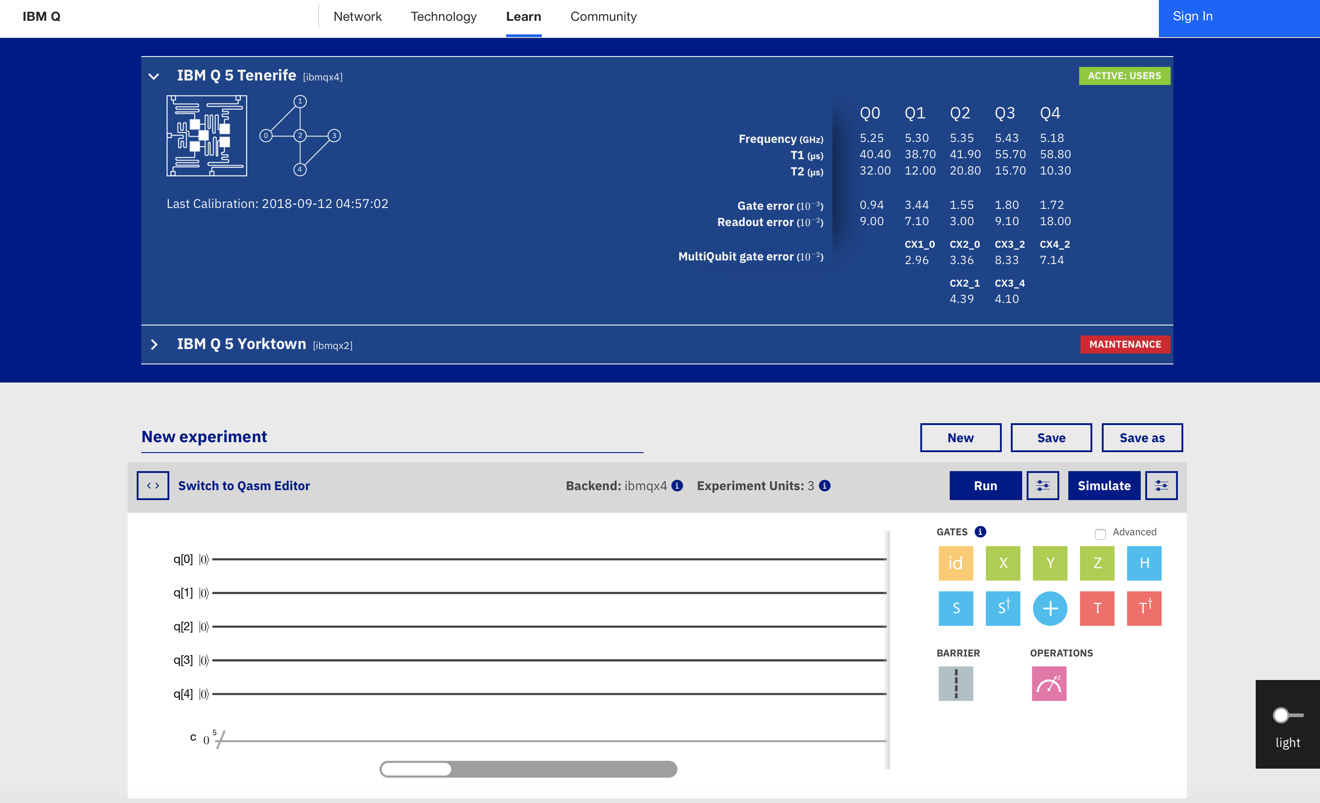
Hello World! Instructions
Navigate to: https://quantumexperience.ng.bluemix.net/qx/editor
Click “sign in”
Choose your favorite identity provider
Login
(Navigate back to composer)

Slide 24
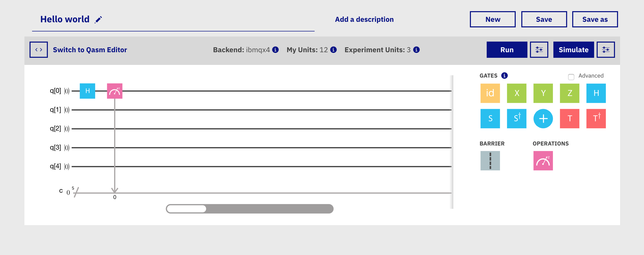
Hello World! (Graphical tool)
Navigate to IBM Q – Composer
New → Select ibmqx2 topology
Build a simple experiment by using a single Hadamard gate and measurement. You can drag and drop the gates
Use the button “simulate” to get the results
Based on what you already know, what should you get as a result?
Validate the result. Was it what you expected?
You can add different gates and tinker around
How many possible results can you achieve with five qubits and five Hadamard gates? Why?
Notes:
Choose backend when creating a new experiment

Slide 25
Hello World! creating a Bell state
Try creating a Bell state with composer
Drag and drop suitable gates and simulate the result
Validate the result! Does it make sense to you?
Notes:
Creates simple entanglement state of two qubits
Finish approximately 14:20 → Break!

Slide 26
CONTECTS
Introduction to Quantum Computing
A Peek into Quantum Information Theory
Hello World! and Beyond
QISKIT and OpenQASM
Introduction to Quantum Algorithms
Conclusions

Slide 27
OpenQASM
OpenQASM (Open Quantum Assembly Language) is an intermediate representation for quantum instructions, published in 2017
Similar to HDL and not yet an assembly language
Has some elements of C and assembly languages
More like traditional hardware description languages such as Verilog, but some more operations added
In OpenQASM only gates and connections between them are available, no loops and jumps for example
Source: https://github.com/Qiskit/openqasm/
Notes:
Similar features to other assembly languages
but not yet an assembly language
No higher-level operations such as loops or jumps
Possibility to add simple gates and connections between them

Slide 28
OpenQASM: What it looks like?
OPENQASM 2.0;
include "qelib1.inc";
qreg q[5];
creg c[5];
h q[1];
h q[2];
s q[1];
s q[2];
h q[2];
cx q[1],q[2];
h q[2];
s q[1];
s q[2];
h q[1];
h q[2];
x q[1];
x q[2];
h q[2];
cx q[1],q[2];
h q[2];
x q[1];
x q[2];
h q[1];
h q[2];
measure q[1] -> c[1];
measure q[2] -> c[2];
The statement
qreg name[size];
declares an array of qubits (quantum register) with the given
Here we add some gates with statements like
h q[1];
Finally measure the output

Slide 29
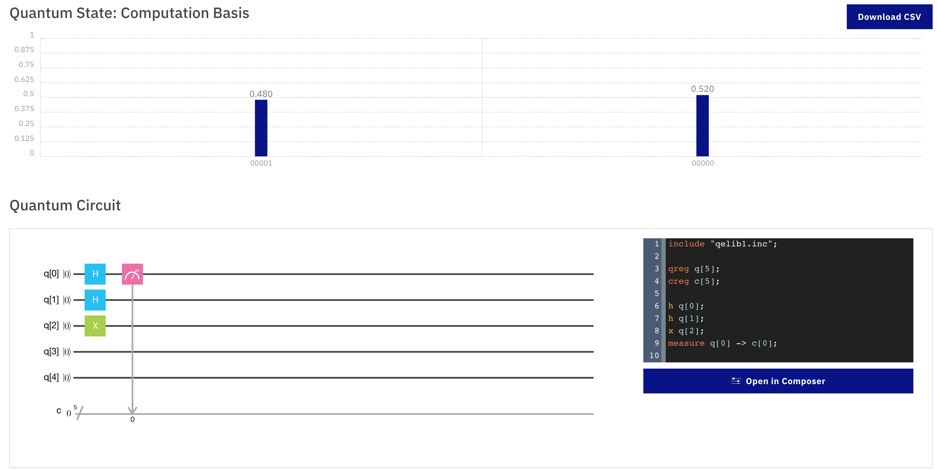
OpenQASM
You can access the corresponding OpenQasm version of any circuit in IBM Q-Composer

Slide 30
QISKIT
What is QISKIT?
QISKIT (Quantum Information Science Kit) is an open-source quantum computing framework
A python SDK to access IBM quantum computing backends and comes also with local simulators.
The starting point for writing code is the QuantumCircuit. Circuits are collections of ClassicalRegister objects, QuantumRegister objects and gates. Through the top-level functions, the circuits can be sent to remote quantum devices or local simulator backends and collect the results for further analysis.
Documentation:
https://qiskit.org/documentation/quickstart.html
SDK ref.: https://qiskit.org/documentation/_autodoc/qiskit.html
Notes:
A python SDK for building quantum circuits
Possible to simulate locally or run on IBM backend

Slide 31
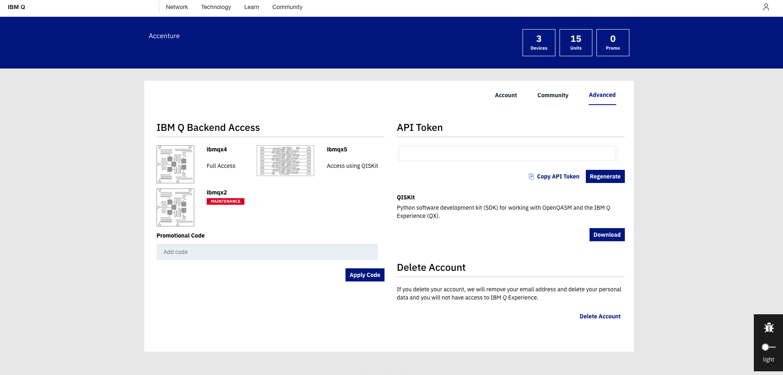
Get your token from IBM Q
Navigate to: https://quantumexperience.ng.bluemix.net/qx/account/advanced
(Account → Advanced)
Copy your API token, you will need it for executing experiments from Qiskit
Your token

Slide 32
QISKIT InstallATIOn Spyder
Installing Python module
$pip install qiskit
Registring your credentials
Needs API Token and the QX URL.
Needs to be done only once.
Import the Qiskit SDK
QX_TOKEN = "728624125ddfb3acc6485060d3c3bbd63e8c1373e65b3e8d1f29fd91417c75f7efa60cccd73f17669da651e24669c8a2865e7c1fcefc01a3879dd5c735003244"
QX_URL = "https://quantumexperience.ng.bluemix.net/api"
from qiskit import register
register(QX_TOKEN, QX_URL)
from qiskit import QuantumCircuit, ClassicalRegister, QuantumRegister
from qiskit import available_backends, execute

Slide 33
QISKIT Jupyter (Pre-installed)
Navigate to https://mybinder.org/v2/gh/HassanNaseri/quantum-computing-handson/master
You can choose any of the ready-made templates and guides to try it out…
… Or you can start from scratch:
File → New Notebook → Python 3
You can run the cells with shift + enter
Configure the token: (this can also be found in the tutorial Getting started - how to use Qiskit.)
import sys, time, getpass
try:
sys.path.append("../../") # go to parent dir
import Qconfig
qx_config = {
"APItoken": Qconfig.APItoken,
"url": Qconfig.config['url’]}
print('Qconfig loaded from %s.' % Qconfig.__file__)
except:
APItoken = getpass.getpass('Please input your token and hit enter: ’)
qx_config = {
"APItoken": APItoken,
"url":"https://quantumexperience.ng.bluemix.net/api"}
print('Qconfig.py not found in qiskit-tutorial directory; Qconfig loaded using user input.')

Slide 34
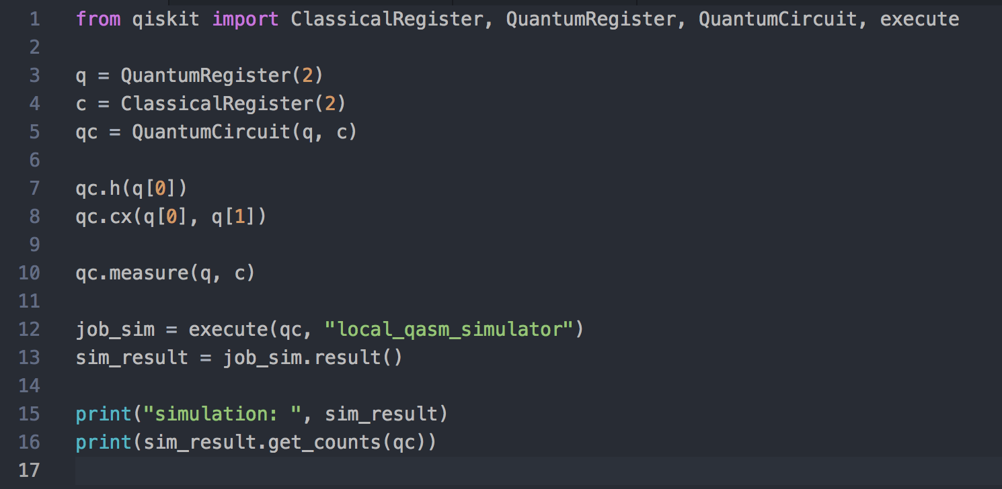
QISKIT
How does it look like?
Initialize a quantum register of 2 qubits and classical register of 2 bits
Initialize a quantum circuit (imagine the circuit in the graphical tool)
Add one Hadamard gate for q[0] and one CNOT-gate between q[0] and q[1]
Measure output and use local simulator as the backend option
print(”Available backends: ", available_backends())
Notes:
Simple gates but also extensions for more complex gates
Its possible to combine normal python code and qiskit code, the classical part will run on classical computer and quantum circuit will be executed on the quantum backend

Slide 35
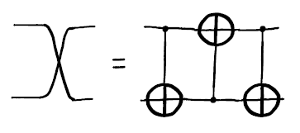
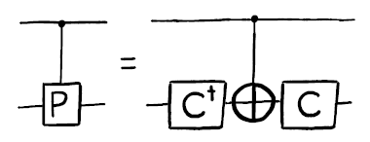
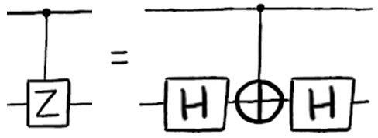
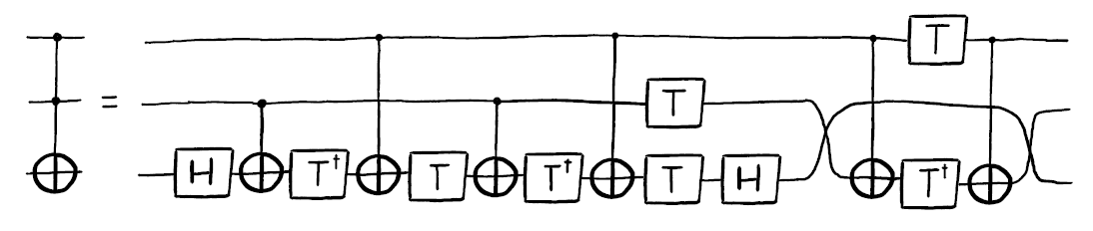
Basic Circuit Identities and Larger Circuits (IBM Q Experience User Guide)
Swapping the states of qubits
Adding a control qubit to a gate
Example: Controlled Z-gate
controlled-Hadamard operation
Toffoli (CCNOT)
Notes:
All the simple gates are available in composer and qiskit, but the more complex ones are not in composer
It is good to know how they can be build from the simple gates
Qiskit has some extensions, where these are available
If somebody is more comfortable with the matrices than the gates and circuits → Show how controlled Z-gate is constructed from matrices
IH x XC x IH

Slide 36
CONTECTS
Introduction to Quantum Computing
A Peek into Quantum Information Theory
Hello World! and Beyond
QISKIT and OpenQASM
The Oracle
Conclusions

Slide 37
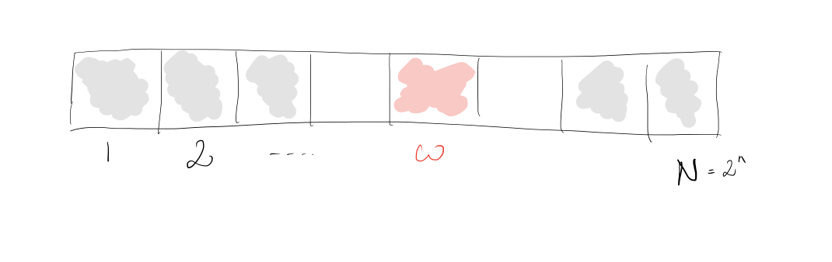
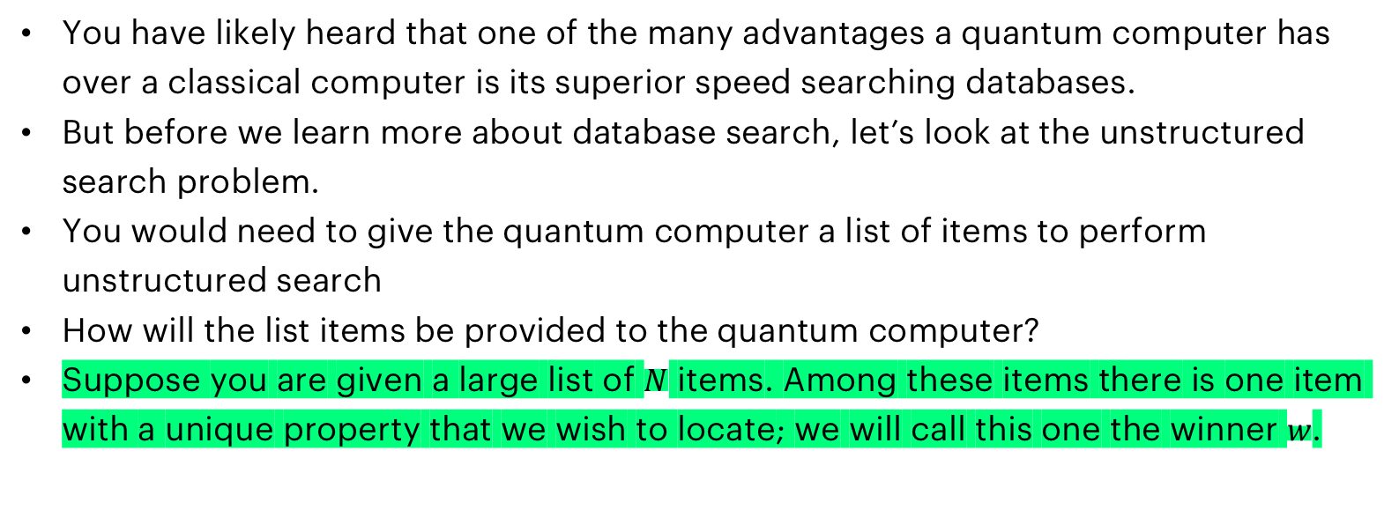
Encoding Data (AKA Oracle) How to represent a list of items in a quantum computer?
You have likely heard that one of the many advantages a quantum computer has over a classical computer is its superior speed searching databases.
But before we learn more about database search, let’s look at the unstructured search problem.
You would need to give the quantum computer a list of items to perform unstructured search
How will the list items be provided to the quantum computer?
Suppose you are given a large list of $N$ items. Among these items there is one item with a unique property that we wish to locate; we will call this one the winner $w$.
Notes:
Later on, we will implement a database search algorithm, which is one of the rare algorithms that actually is proven to have quantum speedup
So, there is a list or set of items, one has unique property, and we will call it the winner ( what we want to find from the database)
First, we want to know, how to implement a checking mechanism or function that will tell us if an item was the winner or not
We will call this function ”the oracle” but you can treat it as a checking mechanism or even an if-condition if that help

Slide 38
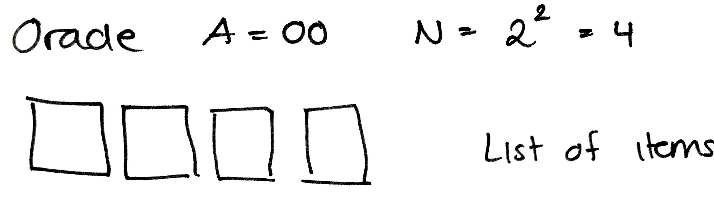
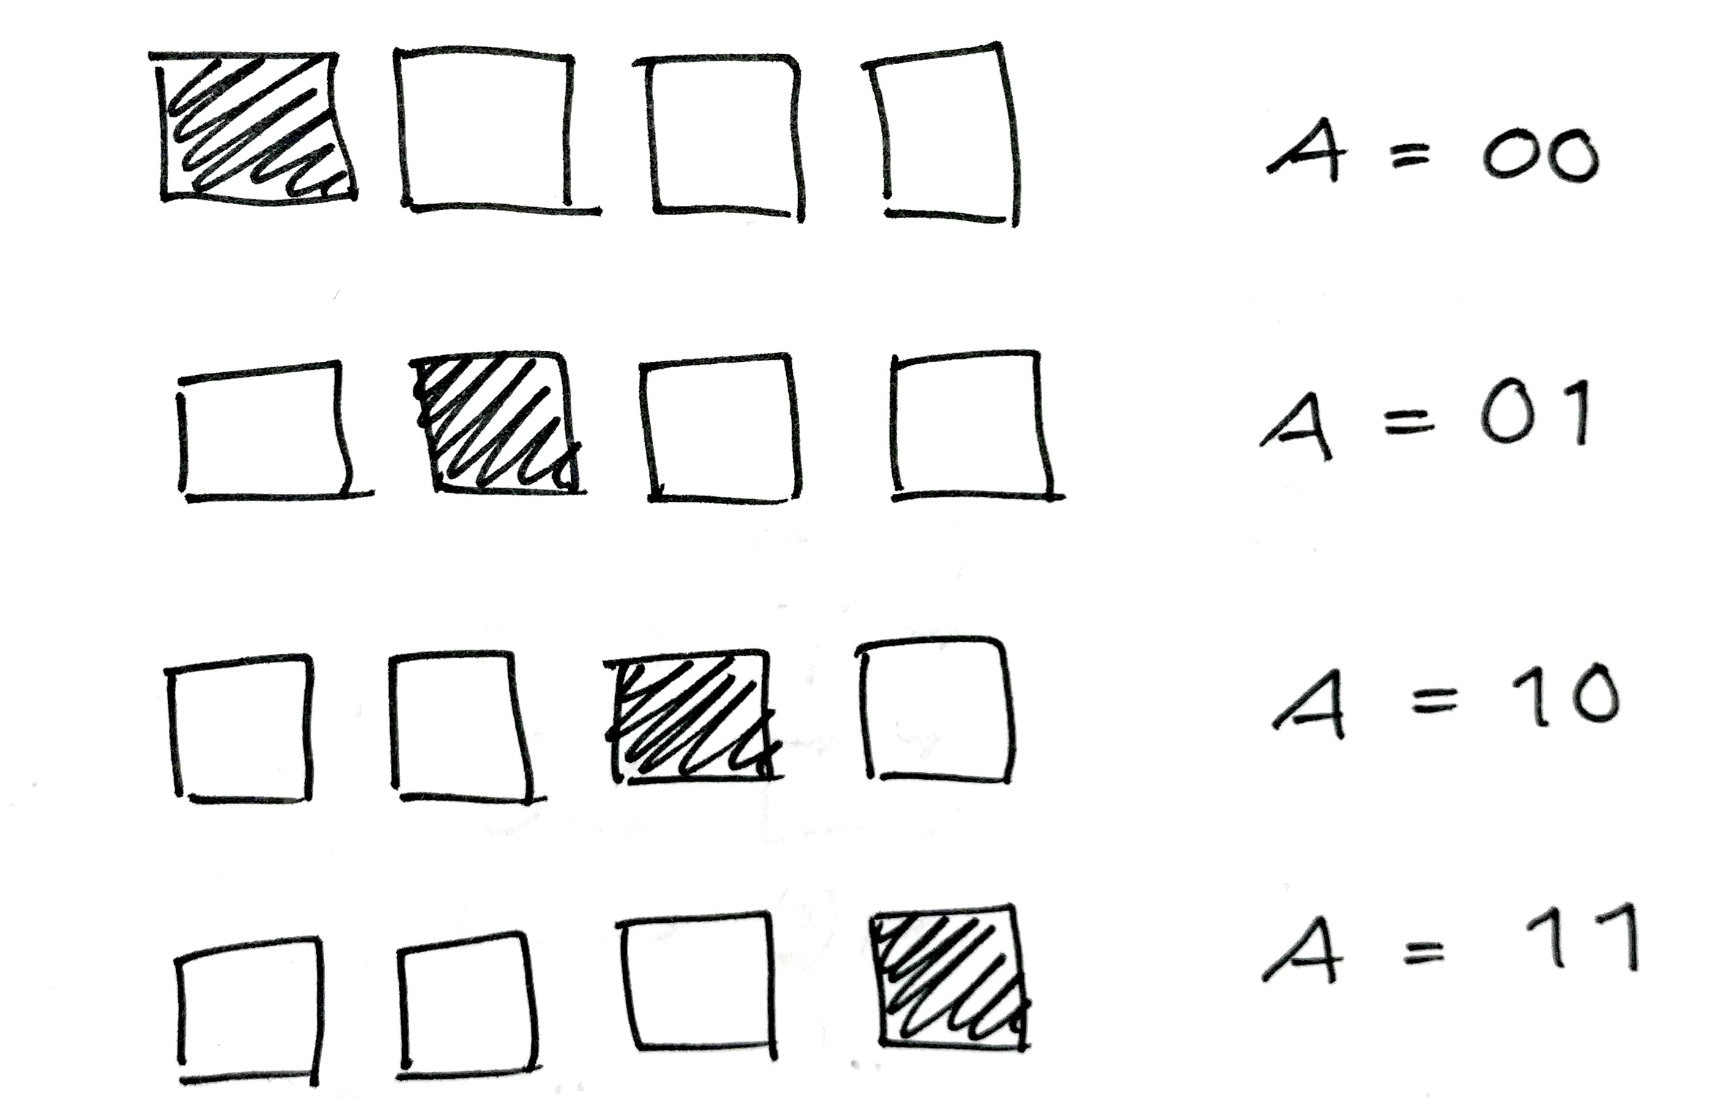
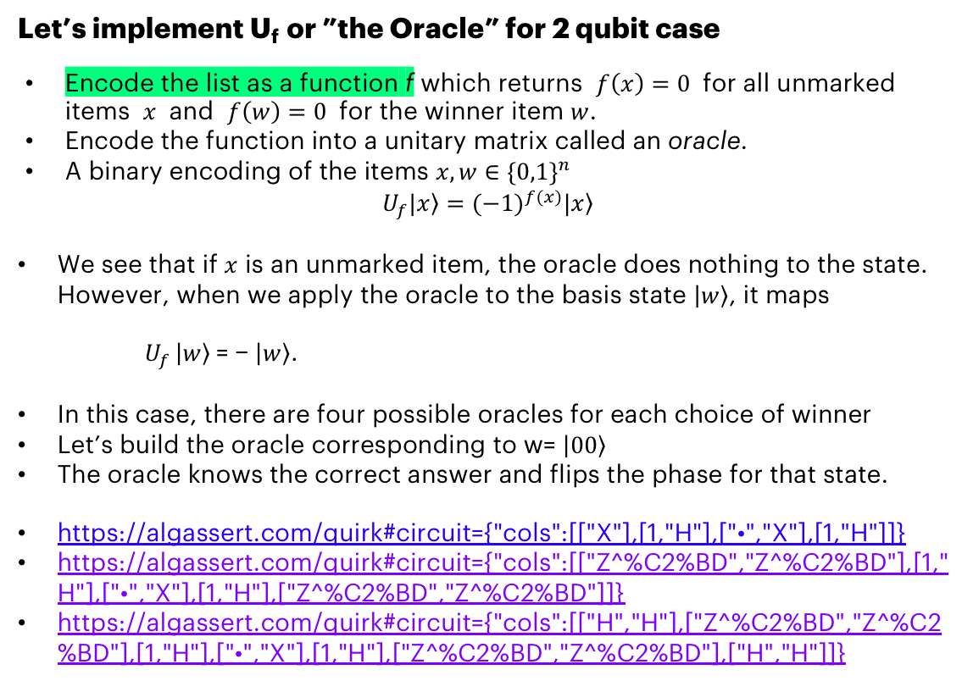
QISKIT Example: The Oracle How to encode a list of items in a quantum computer?
Let’s implement U_{f} or ”the Oracle” for 2 qubit case
Encode the list as a function f which returns $f\left(x\right)=0$ for all unmarked items $x$ and $f\left(w\right)=0$ for the winner item $w$.
Encode the function into a unitary matrix called an oracle.
A binary encoding of the items $x,w∈{\{0,1\}}^{n}$
$$U_{f}|\left.x\right\rangle ={(−1)}^{f(x)}|\left.x\right\rangle$$
We see that if $x$ is an unmarked item, the oracle does nothing to the state. However, when we apply the oracle to the basis state $\left|\left.w\right\rangle \right.$, it maps
$U_{f }\left|\left.w\right\rangle \right.$= − $\left|\left.w\right\rangle \right.$.
In this case, there are four possible oracles for each choice of winner
Let’s build the oracle corresponding to w= $\left|\left.00\right\rangle \right.$
The oracle knows the correct answer and flips the phase for that state.
https://algassert.com/quirk#circuit={"cols":[["X"],[1,"H"],["•","X"],[1,"H"]]}
https://algassert.com/quirk#circuit={"cols":[["Z^%C2%BD","Z^%C2%BD"],[1,"H"],["•","X"],[1,"H"],["Z^%C2%BD","Z^%C2%BD"]]}
https://algassert.com/quirk#circuit={"cols":[["H","H"],["Z^%C2%BD","Z^%C2%BD"],[1,"H"],["•","X"],[1,"H"],["Z^%C2%BD","Z^%C2%BD"],["H","H"]]}
Four possible Oracles:
Notes:
We will give the inputs to the oracle → it checks if this was the winner → it will swap the phase of the amplitude corresponding to the winner state
If statement of a database
Explain with binary initialization first, then superposition state.
This type of encoding is not the only way to do the check, but this particular way will be useful later

Slide 39
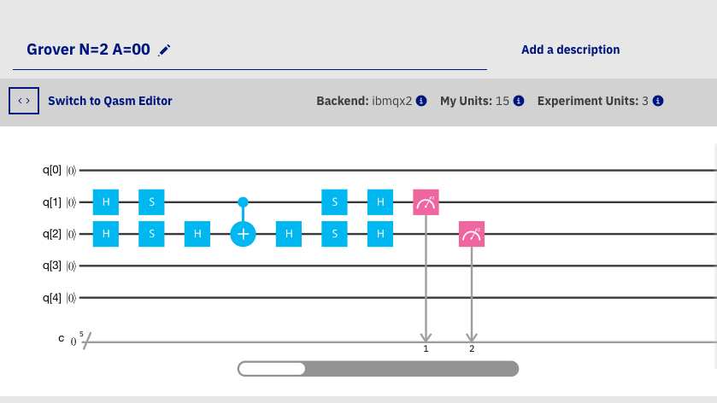
QISKIT Exercise: The Oracle How to encode a list of items?
Implement the above circuit in Qiskit.
The outcome should be a uniform distribution (the amplitudes cannot be masured).
Notes:
Explain that Hadamards are not part of the Oracle logic, but it is used to initialize the uniform distribution
No way to see the amplitudes here, but it is possible in Quirk if you would like to play around
Another way to see the amplitudes is to validate the logic via linear algebra → we will do this next

Slide 40
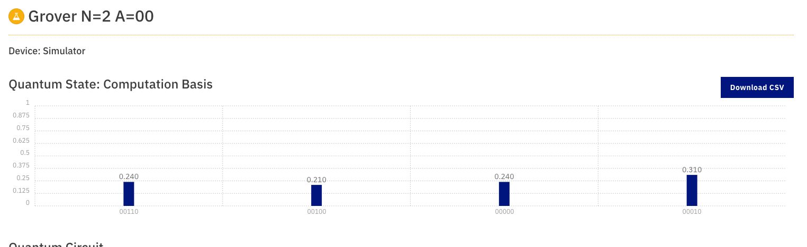
QISKIT Exercise: The Oracle (SOLUTION)
from qiskit import ClassicalRegister, QuantumRegister, QuantumCircuit, execute
# Initialize the circuit
q = QuantumRegister(5)
c = ClassicalRegister(5)
qc = QuantumCircuit(q, c)
# Add gates
qc.h(q[1])
qc.h(q[2])
qc.s(q[1])
qc.s(q[2])
qc.h(q[2])
qc.cx(q[1], q[2])
qc.h(q[2])
qc.s(q[1])
qc.s(q[2])
qc.h(q[1])
qc.h(q[2])
qc.measure(q, c)
job_sim = execute(qc, "local_qasm_simulator")
sim_result = job_sim.result()
print("simulation: ", sim_result)
print(sim_result.get_counts(qc))
Uniform distribution (the amplitudes are not shown here):
Notes:
Explain that Hadamards are not part of the Oracle logic, but it is used to initialize the uniform distribution
No way to see the amplitudes here, but it is possible in Quirk if you would like to play around
Another way to see the amplitudes is to validate the logic via linear algebra → we will do this next

Slide 41
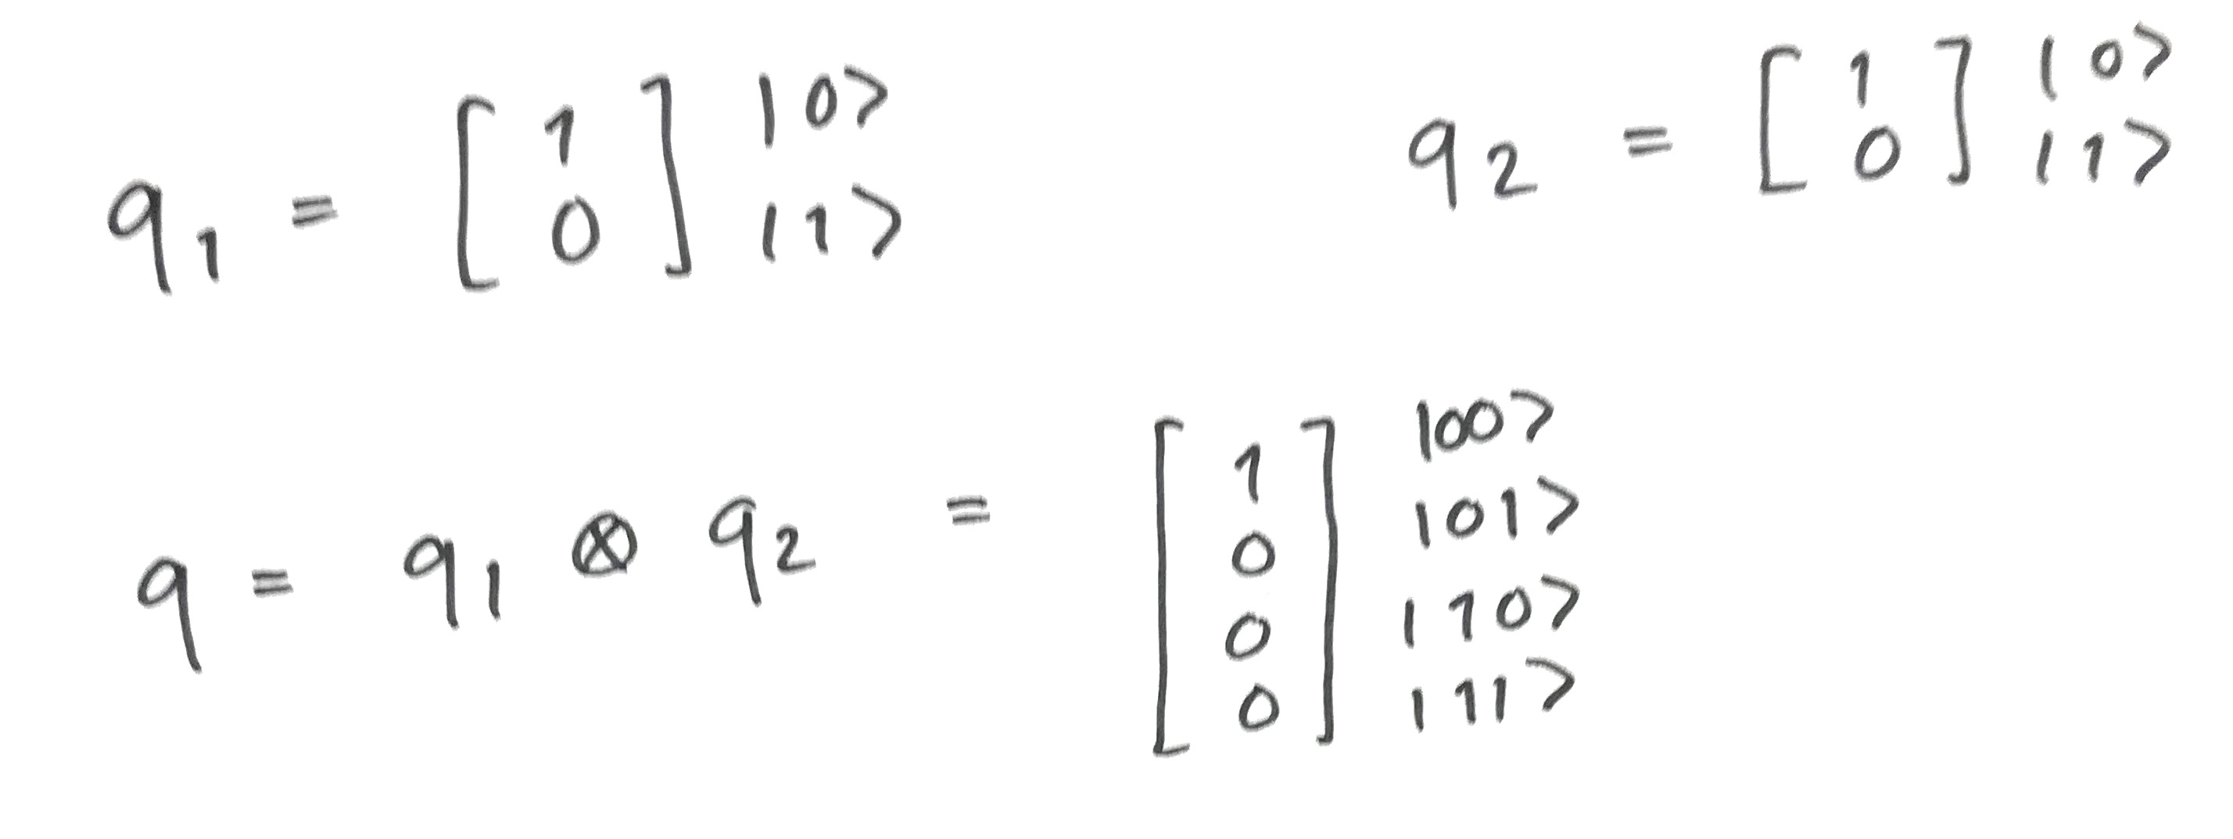
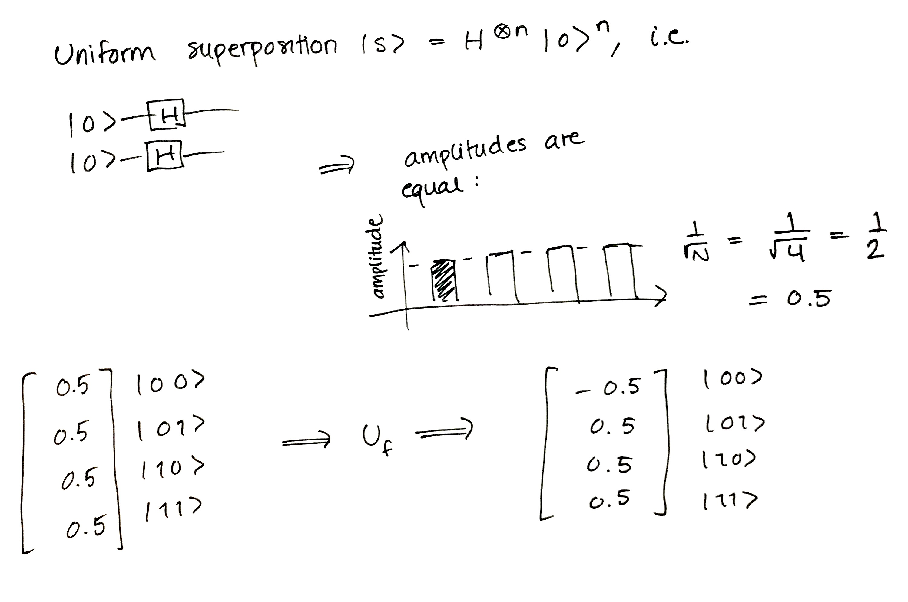
TEST The Oracle LOGIC LINEAR ALGEBRA IN PYTHON
import numpy as np
q1 = np.array([[1,0]])
q2 = np.array([[1,0]])
# Some basic gates
I = np.array([[1,0],[0,1]])
H = (1/np.sqrt(2))*np.array([[1,1],[1,-1]])
X = np.array([[0,1],[1,0]])
Y = np.array([[0,-1j],[1j,0]])
Z = np.array([[1,0],[0,-1]])
S = np.array([[1,0],[0,1j]])
CX = np.array([[1,0,0,0],[0,1,0,0],[0,0,0,1],[0,0,1,0]])
# ------- start in a separate basis for each qubit -------
t1_0 = q1.dot(H).dot(S)
t1_1 = q2.dot(H).dot(S).dot(H)
# CNOT makes them entangled, there is no way to invert this (split
# them)
t2 = np.kron(t1_0, t1_1).dot(CX)
t3 = t2.dot(np.kron(I,H)).dot(np.kron(S,S)).dot(np.kron(H,H))
print('State \t|00⟩\t\t|01⟩\t\t|10⟩\t\t|11⟩')
print ('\t'+'\t'.join('{}'.format(i) for i in np.round(t3[0,:],2)))
Notes:
This is the code to validate the logic in python and see the amplitudes
You can also do it in pen and paper (it’s fun to do maybe once)

Slide 42
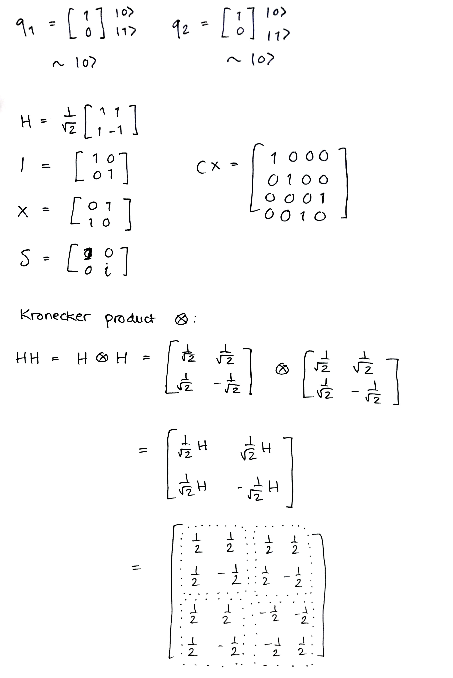
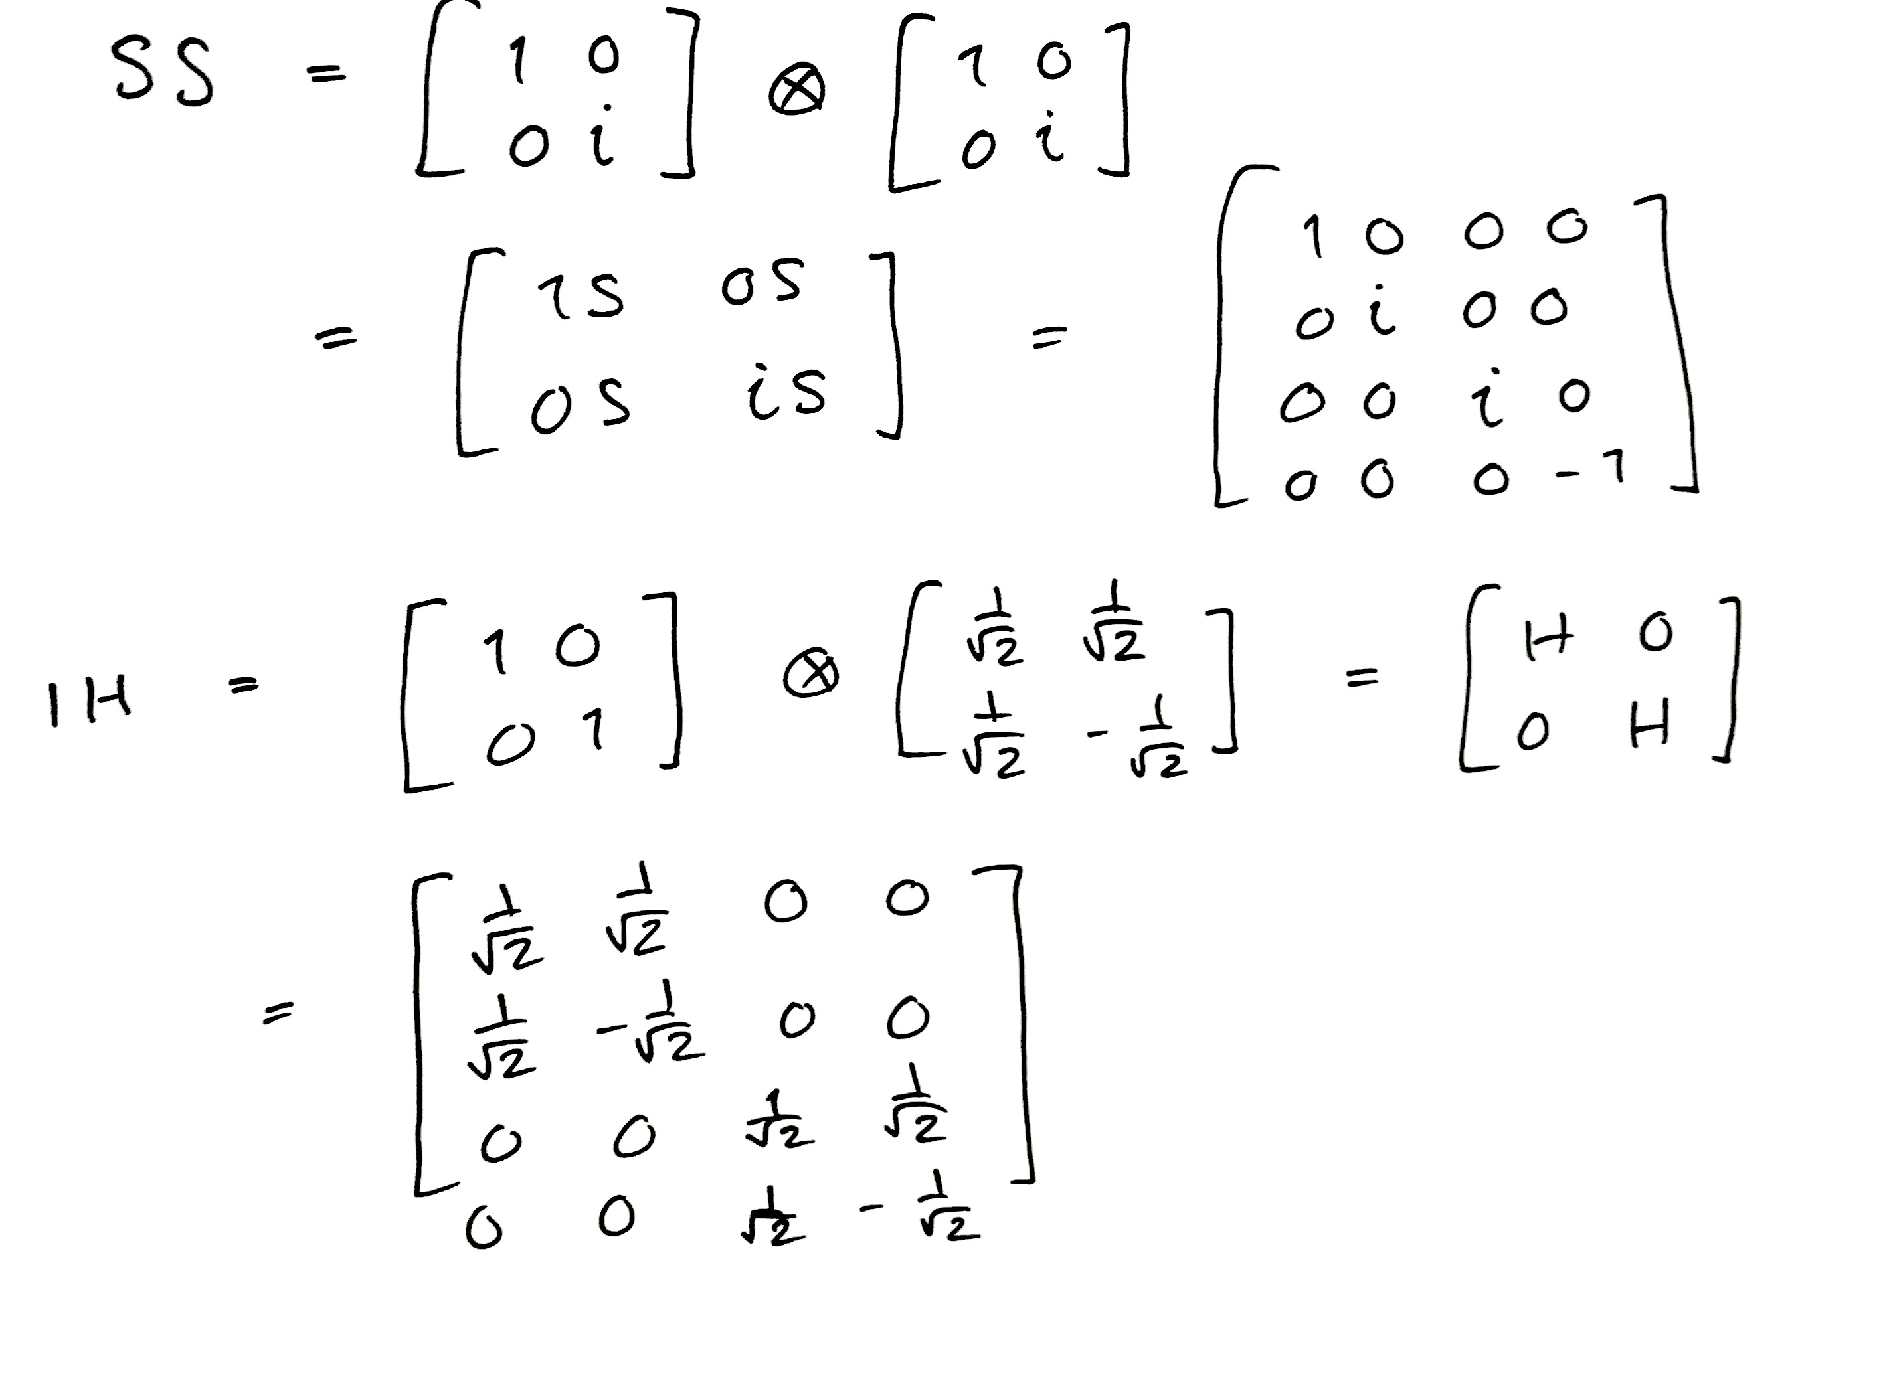
TEST The Oracle LOGIC LINEAR ALGEBRA
You can even verify this with basic matrix multiplications, pen & paper…

Slide 43
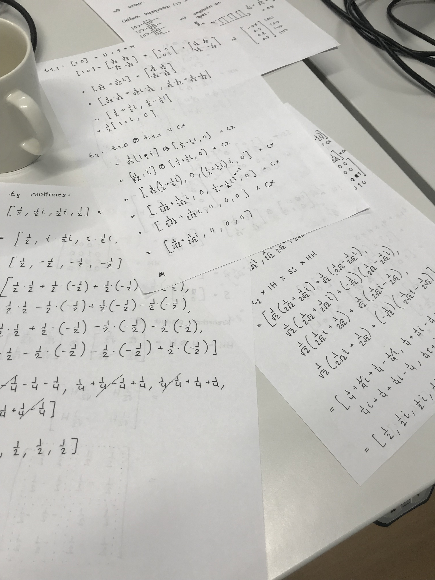
TEST The Oracle LOGIC LINEAR ALGEBRA
… But maybe python is faster
Notes:
Finish approx. 15:40

Slide 44
CONTECTS
Introduction to Quantum Computing
A Peek into Quantum Information Theory
Hello World! and Beyond
QISKIT and OpenQASM
Introduction to Quantum Algorithms
Conclusions

Slide 45

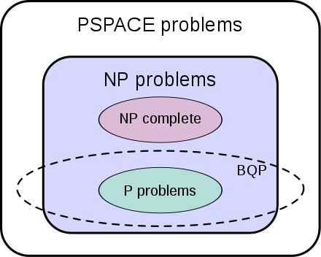
It is all about Complexity! NOT PERFORMANCE
Q: What can we use a quantum computer for?
Computation resources: space and time
Processing time/power, storage/memory space, other units energy, cost, etc.
Polynomial (P) versus non-polynomial (NP) problems
Difference between tractable and intractable.
PTIME or simply P: problems that can be solved by in a polynomial amount of computation time.
PSPACE: problems that can be solved using a polynomial amount of space.
Example:
A UPS truck wants to deliver 400 packets in Helsinki. The TSP has complexity O(2⁴⁰⁰), which is longer than the age of universe even in microseconds.
With polynomial complexity O(400^{p}), it would take few minutes for small p, e.g., with p=5 (e.g. on a 50GFLOPS machine)
Quadratic speedup can be also significant. The problem of complexity O(2²⁰) can be solved in a fraction of a second.
There are many intractable problems (we usually approximate answers):
Why can’t we reliably predict next week’s whether? What about this week next year? Can we find a cure for cancer by testing all possible interactions of known chemicals and human body cells? Can we optimally solve the Wall Street portfolio management problem?
A quantum computer is not generally faster, parallel.
A qubit does not always store more information than a bit.
Quantum speedup (There are problems which are classically hard and quantumly easy!)
There exist quantum algorithms to solve classical problems with less complexity than their classical counterparts.
Bounded-error quantum polynomial time (BQP): problems solvable by a quantum computer in polynomial time, with an error probability of at most 1/3.
Exponential speedup: some problems classically in NP are in BQP, i.e. there are algorithms that
Quadratic speedup: some problems in P or NP can get quadratic speedup using quantum algorithms.
A problem can get quantum speedup if there exists a quantum algorithm to solve that problem in faster than any classical algorithm.
Well-known NP-complete problems:
Boolean satisfiability problem (SAT)
Knapsack problem
Hamiltonian path problem
Travelling salesman problem (TSP)
Subgraph isomorphism problem
Subset sum problem
Clique problem
Vertex cover problem
Independent set problem
Dominating set problem
Graph coloring problem

Slide 46
Quantum Algorithms
The space of a quantum system grows exponentially, hence the number of possible random outcomes.
There are three categories of quantum algorithms:
Based on quantum Fourier transform (QFT) (exponential speedups)
Shor's algorithm: factorization of prime numbers
Quantum algorithm for linear systems of equation
Based on amplitude amplification (quadratic speedups)
Grover's algorithm: searches an unstructured database
Based on quantum walks
It is difficult to design a new Quantum algorithm!

Slide 47
Problems to Solve
UNIVERSAL QUANTUM COMPUTING
Cryptography (Shor’s algorithm for Integer factorization)
A practical algorithm with corresponding optimized non-quantum algorithm, Well-studied, several implementations, exponential speedup, large impact. [1994, Bell Labs]
Discrete Optimization and Database Search
There is a possibility of quadratic speedup for some combinatorial optimization and integer programming problems, which are in NP with exponential complexity.
Grovers algorithm [1996, Bell Labs]
Tarvelling salesman problem (TSP) is NP-complete. There is no quantum algorithm to solve it in polynomial time yet. But there are two approaches that promise quadratic speedup.
Moylett, Dominic J., Noah Linden, and Ashley Montanaro. "Quantum speedup of the traveling-salesman problem for bounded-degree graphs." Physical Review A 95.3 (2017), https://arxiv.org/abs/1612.06203
OTHER AREAS (NOT GATE MODEL)
Quantum simulation (Chemistry/Physics simulator)
Still a very new field and only few experiments have been carried out in research labs.
July 2018, first claim of multi-qubit demonstration of a quantum chemistry. https://www.sciencedaily.com/releases/2018/07/180724110028.htm
September 2017, Computation of molecular spectra, IBM research, nature. https://www.nature.com/articles/nature23879
Approximation algorithms
Quantum Annealing
Quantum Communication
Not quantum computing per se. Example: Quantum Key Distribution (QKD), not in the scope of this project.
An overview of Quantum Information Systems: https://ieeexplore.ieee.org/document/6707155/

Slide 48
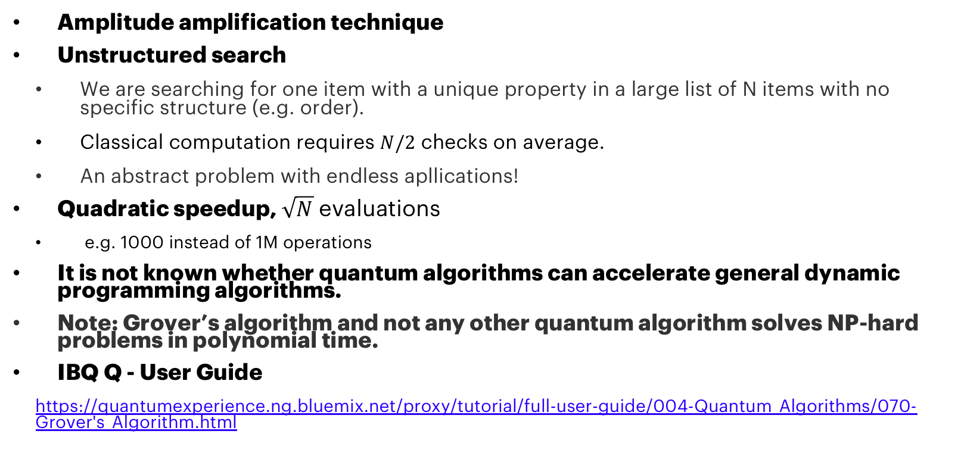
Grover’s Algorithm
Amplitude amplification technique
Unstructured search
We are searching for one item with a unique property in a large list of N items with no specific structure (e.g. order).
Classical computation requires $N/2$ checks on average.
An abstract problem with endless apllications!
Quadratic speedup, $\sqrt{N}$ evaluations
e.g. 1000 instead of 1M operations
It is not known whether quantum algorithms can accelerate general dynamic programming algorithms.
Note: Grover’s algorithm and not any other quantum algorithm solves NP-hard problems in polynomial time.
IBQ Q - User Guide
https://quantumexperience.ng.bluemix.net/proxy/tutorial/full-user-guide/004-Quantum_Algorithms/070-Grover's_Algorithm.html

Slide 49
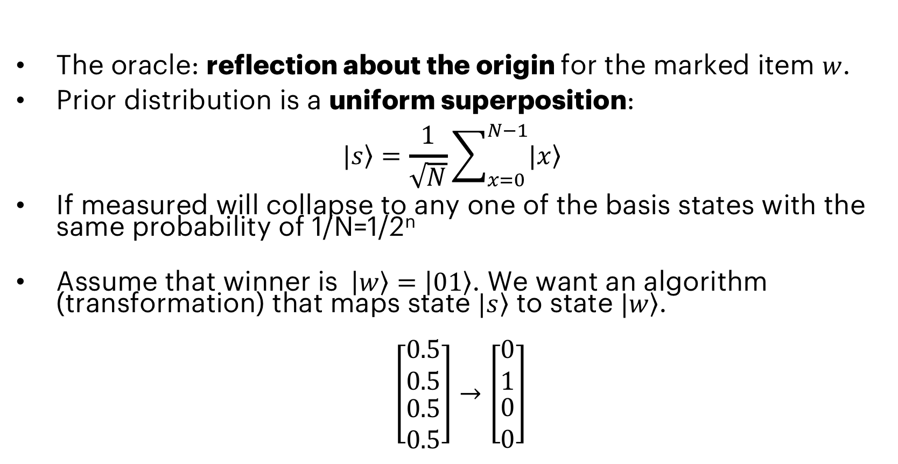
GROVER’S: Providing the List (Function) The ORACLE
The oracle: reflection about the origin for the marked item $w$.
Prior distribution is a uniform superposition:
$$|\left.s\right\rangle =\frac{1}{\sqrt{N}}\sum_{x=0}^{N−1}{|\left.x\right\rangle }$$
If measured will collapse to any one of the basis states with the same probability of 1/N=1/2^{n}
Assume that winner is $\left|\left.w\right\rangle \right.=\left|\left.01\right\rangle \right.$. We want an algorithm (transformation) that maps state $|\left.s\right\rangle$ to state $|\left.w\right\rangle$.
$\left[\begin{matrix}0.5 \\ 0.5 \\ \begin{aligned}0.5 \\ 0.5\end{aligned}\end{matrix}\right]→\left[\begin{matrix}0 \\ 1 \\ \begin{aligned}0 \\ 0\end{aligned}\end{matrix}\right]$

Slide 50





GROVER’s: Amplitude Amplification reflection about the AVERAGE
This procedure amplifies the amplitude of the marked item and shrinks the other amplitudes.
Measurement will collapse to the correct solution with high probability.
A nice geometrical interpretation in terms of two reflections.
The vectors |w⟩ and |s⟩ span a two-dimensional plane in the vector space ℂ^{N}. Let us, introduce |s′⟩ that is obtained from |s⟩ by removing |w⟩. Then, |w⟩ and |s′⟩ are the basis of this vector space.
step 0 Initialize the uniform superposition, $|\left.ψ_{0}\right\rangle =|\left.s\right\rangle$.
step 1 Apply the oracle reflection $U_{f}$ to the state $U_{f}|\left.ψ_{t}\right\rangle =$ $|\left.ψ_{t^{′}}\right\rangle$, i.e., reflection of $|\left.ψ_{t}\right\rangle$ about |s′⟩ (towars −|w⟩).
step 2 apply an additional reflection Us about the state |s⟩, i.e., Us=2|s⟩⟨s|−𝟙. Complete tranformation becomes $|\left.ψ_{t+1}\right\rangle =$ $U_{s}U_{f}|\left.ψ_{t}\right\rangle$. The transformation UsUf rotates the initial state |s⟩ closer towards the winner |w⟩.
Goto step 1 and repeat $\sqrt{N}$ times.
Intution: $U_{s}$ is a reflection about the average amplitude. Since the average amplitude was lowered by the first reflection, this transformation boosts the negative amplitude of |w⟩ to roughly three times.
Scalability and complexity: the amplitude of |w⟩ grows linearly with the number of applications. Applying $\sqrt{N}$ operation, keeps the probability constant. Hence, called amplitude amplification.

Slide 51






Grover’s : Implementation
$$U_{f}$$
$$U_{s}$$
Implement this using QISKIT or Graphic composer.
Initialize: Hadamard
Uf: using control-Z gate, made from CNOTs
Us: using control-Z gate.
Examples
Grover N=2 A=00
Grover N=2 A=01
Grover’s algorithm: N=2, A=00
$$U_{f}$$
$$U_{s}$$
Grover’s algorithm N=2, A=01

Slide 52
Grover’s : QUISKIT EXERCISE
from qiskit import ClassicalRegister, QuantumRegister, QuantumCircuit, execute
def black_box_u_f(circuit, q):
# black box function to encode a winner entry
w = 2 # possible winners: 0,1,2,3
print("hidden winner: {0:#b}".format(w))
if w&2 == 0:
circuit.s(q[0])
if w&1 == 0:
circuit.s(q[1])
circuit.h(q[1])
circuit.cx(q[0], q[1])
circuit.h(q[1])
if w&2 == 0:
circuit.s(q[0])
if w&1 == 0:
circuit.s(q[1])
def reflection_about_average(circuit, q):
# Reflection about average for amplitude amplification
...
# Define reqisters and circuit
qreg = QuantumRegister(2)
creg = ClassicalRegister(2)
grover = QuantumCircuit(qreg, creg)
# Initialization of quantum registers
...
# Grover's amplitude amplification (only one iteration here)
...
# Add Measurement
grover.measure(qreg, creg)
# Execute and collect results
job_sim = execute(grover, "local_qasm_simulator")
sim_result = job_sim.result()
# Print result counts
print("simulation: ", sim_result)
print(sim_result.get_counts(grover))

Slide 53
Grover’s : Implementation - Code
from qiskit import ClassicalRegister, QuantumRegister, QuantumCircuit, execute
def black_box_u_f(circuit, q):
# black box function to encode a winner entry
w = 2 # possible winners: 0,1,2,3
print("hidden winner: {0:#b}".format(w))
if w&2 == 0:
circuit.s(q[0])
if w&1 == 0:
circuit.s(q[1])
circuit.h(q[1])
circuit.cx(q[0], q[1])
circuit.h(q[1])
if w&2 == 0:
circuit.s(q[0])
if w&1 == 0:
circuit.s(q[1])
def reflection_about_average(circuit, q):
# Reflection about average for amplitude amplification
circuit.h(q[0])
circuit.h(q[1])
circuit.x(q[0])
circuit.x(q[1])
circuit.h(q[1])
circuit.cx(q[0], q[1])
circuit.h(q[1])
circuit.x(q[0])
circuit.x(q[1])
circuit.h(q[0])
circuit.h(q[1])
# Define reqisters and circuit
qreg = QuantumRegister(2)
creg = ClassicalRegister(2)
grover = QuantumCircuit(qreg, creg)
# Initialization of quantum registers
grover.h(qreg[0])
grover.h(qreg[1])
# Grover's amplitude amplification (only one iteration here)
black_box_u_f(grover, qreg)
reflection_about_average(grover, qreg)
# Add Measurement
grover.measure(qreg, creg)
# Execute and collect results
job_sim = execute(grover, "local_qasm_simulator")
sim_result = job_sim.result()
# Print result counts
print("simulation: ", sim_result)
print(sim_result.get_counts(grover))
Jupyter notebook example from Quiskit tutorial (more qubits):
https://github.com/Qiskit/qiskit-tutorial/blob/master/reference/algorithms/grover_algorithm.ip

Slide 54






If curious, simulate yourself in python or do it on paper!
﻿import numpy as np
import numpy.linalg as la
# Print setting for arrays
np.set_printoptions(formatter={'float': '{: 0.2f}'.format})
# The winner state to find.
w = np.array([0, 1, 0, 0])
N = len(w)
print("w: {:}".format(w))
# Unifrom superosition, prior state
s = (1/np.sqrt(N)) * np.ones(N)
# Find unit vector |sp> as a component of |s> orthogonal to |w>
sp = (s - w.dot(s)*w)
sp = sp/la.norm(sp)
print("sp: {:}".format(sp))
# Reflection about sp (inversion)
Uf = np.array(2*np.outer(sp,sp) - np.eye(N))
print("Uf: {:}".format(Uf))
# Reflection about s (about average)
Us = np.array(2*np.outer(s,s)-np.eye(N))
print("Us: {:}".format(Us))
Psi2 = Uf.dot(s)
print("Uf.s: {:}".format(Psi2))
result = Us.dot(Psi2)
print("Result: {:}".format(result))

Slide 55
CONTECTS
Introduction to Quantum Computing
A Peek into Quantum Information Theory
Hello World! and Beyond
QISKIT and OpenQASM
Introduction to Quantum Algorithms
Conclusions

Slide 56
LIMITATIONS in hardware
There is no standard technology-topology yet.
The openQASM code is topology-dependent
The current quantum computers have very limited sizes.
Encoding classic bits: 1 qubit = 1 bit
The quantum computers are very few.
A practical business case requires many affordable computers/services to become available.
The coherence time of the hardware is limited, < 100 us.
The current technology is not fault-tolerant (noise limit the size)
The error rate for a 2-qubit gate is above 0.1%, hence limiting circuit sizes to the order of 1000 qates.

Slide 57
POSSIBILITIES IN AlgorithmS
Qiskit SDK
Extensions: qiskit-terra/qiskit/extensions/standard/
Qiskit Aqua
Qiskit Algorithms for Quantum Applications (Qiskit Aqua)
Library of algorithms for quantum computing that uses Qiskit Terra.
Build applications for Noisy Intermediate-Scale Quantum (NISQ) computers.
https://qiskit.org/documentation/aqua/
Many other repositories:
Aqua Chemistry, Aqua Optimization, Aqua Artificial Intelligence.
Qiskit Aqua Algorithms
Variational Quantum Eigensolver (VQE)
Quantum Approximate Optimization Algorithm (QAOA)
Quantum Dynamics
Quantum Phase Estimation (QPE)
Iterative Quantum Phase Estimation (IQPE)
Quantum Grover Search
Support Vector Machine Quantum Kernel (SVM Q Kernel)
Support Vector Machine Variational (SVM Variational)

Slide 58
SOME Resources
A good introductory tutorial on quantum computing: https://people.cs.umass.edu/~strubell/doc/quantum_tutorial.pdf
A video series on quantum computing (YouTube): https://www.youtube.com/watch?v=X2q1PuI2RFI&list=PL1826E60FD05B44E4
IBM Q Experience user guide: https://quantumexperience.ng.bluemix.net/proxy/tutorial/full-user-guide/introduction.html
A nice tool for learning (QUIRK): https://algassert.com/quirk
A white paper from Accenture Labs (Innovating with Quantum Computing): https://www.accenture.com/t00010101T000000__w__/br-pt/_acnmedia/PDF-45/Accenture-Innovating-Quantum-Computing-Novo.pdf
Quantum Developer Week, Accenture Media Exchange: https://mediaexchange.accenture.com/media/t/0_s769log0
Quantum Computing Lecture including Linear Algebra (The University of Chicago) http://people.cs.uchicago.edu/~razborov/teaching/QuantumComputing/notes.pdf
Grover’s algorithm: https://www.cs.cmu.edu/~odonnell/quantum15/lecture04.pdf
For a curious mind: Richard Feynman’s lecture on quantum mechanics: https://www.youtube.com/watch?v=OYp_Mq_-Q0s

Slide 59
Thank you

